Slide 1

Stock Price Trend Prediction using Machine Learning on Financial Statements
James Liao 490851
Lawrence Yang 489746
Ming Xu 489773
Yanzhong Lai 489763
EyeCatching Capital

Slide 2
Content
Background
Data Description and Pre-Processing
Methodology
Multiples Filtration and Optimization
Related Models
Expected Result
References
EyeCatching Capital

Slide 3
Background
Fundamental analysis is important to evaluate a company's fair value and long-term investment opportunities
Multiples interpret companies operating status, financial status, and sales performance, etc
Few research in finding the significance of each multiple on stock trends prediction
Main goal: Find out the coefficient of each multiple using ML/DL algorithms to predict stock price movements
EyeCatching Capital

Slide 4
Data Description and Pre-Processing
Financial data via broker’s API such as Morning Star or TD Ameritrade
Total 29 financial multiples as variables
Total of 40000 rows if consider all 500 companies in last 20 years
Assign the label: Rise or Fall to each row (quarterly)
Group by industry
EyeCatching Capital

Slide 5
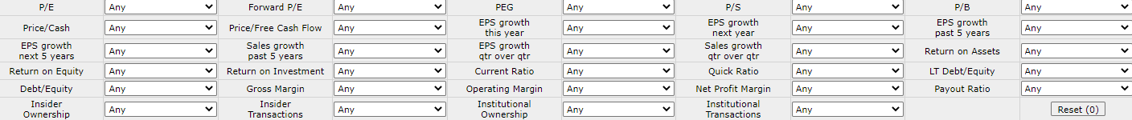
Methodology- Total Multiples
Free Stock Screener (finviz.com)
EyeCatching Capital

Slide 6
Methodology- Selected Multiples
LIQUIDITY
current ratio
quick ratio
ACTIVITY
asset turnover
collection period
payment period
Multiples
VALUATION
P/E
EPS
PROFITABILITY
ROA
ROE
SOLVENCY
debt-to-asset
interest coverage
EyeCatching Capital

Slide 7
Methodology — Related Models
Non-linear
Non-stationary
Stock Market Data
Political & Economic impact
Investor behaviors
……
Prices Prediction
Trends Prediction
EyeCatching Capital

Slide 8
Methodology — Related Models
Choose the hybrid system with the best performance
SVM
Accuracy 1
Filtering
Selected Multiples
Multiples
Benchmark
RNN
Accuracy 2
LSTM
Accuracy 3
Random Forests
GRU
Accuracy 4
EyeCatching Capital

Slide 9
Expected Result
We expect under given period, our strategy can generate higher sharpe ratio, lower maximum drawdown, and lower volatility in the same stock because we will take actions like close the position as the risk is detected other than simply holding the stock.
It is also expected that the model performance would be different before and after negative macro events, such as the financial crisis in 2008 and the covid-19 epidemic in 2021.
EyeCatching Capital

Slide 10
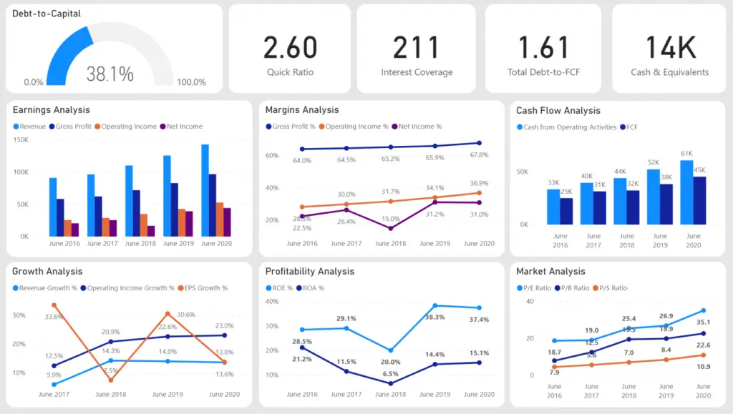
Expected Result
Tableau Interactive Dashboard
Price movement forecasting (Rise / Fall)
Historical performance
Multiples overview
Benchmark ratios- Industry average
Source: Stock Market Analysis - The Babylonians (theancientbabylonians.com)
EyeCatching Capital

Slide 11
Timeline
2/9 | 2/16 | 2/23 | 3/2 | 3/23 | 3/30 | 4/20 | 4/27
API connection finish | Database finish | Finish first model on two different multiples selection | Mid-term presentation | Model adjustment and, try the rest of the models | Finish all the models and optimization | Rough draft and slides finish | Final presentation
EyeCatching Capital

Slide 12
References
[1] Jermsittiparsert, Kittisak & Ambarita, Dedy & Mihardjo, Leonardus & K Ghani, Erlane. (2019). Risk-Return through Financial Ratios as Determinants of Stock Price: A Study from ASEAN Region. Journal of Security and Sustainability Issues. 9. 199-210. 10.9770/jssi.2019.9.1(15).
[2] Deji-Olarerin A , Folorunso O , Vincent O R , et al. STOCK PRICE TREND PREDICTION USING SUPPORT VECTOR MACHINE AND CORAL REEF OPTIMIZATION ALGORITHM[J]. 2020.
[3] Nair B B , Mohandas V P , Sakthivel N R . A Genetic Algorithm Optimized Decision Tree-SVM based Stock Market Trend Prediction System[J]. International Journal on Computer Science & Engineering, 2010, 2(9).
[4]Amel-Zadeh, Amir and Calliess, Jan-Peter and Kaiser, Daniel and Roberts, Stephen, Machine Learning-Based Financial Statement Analysis (November 25, 2020).
[5]Akhtar, T. (2021). Market multiples and stock returns among emerging and developed financial markets. Borsa Istanbul Review, 21(1), 44-56.
[6] Junyoung, Heo, Jin, et al. SVM based Stock Price Forecasting Using Financial Statements[J]. KIISE Transactions on Computing Practices, 2015, 21(3):167-172.
EyeCatching Capital

Slide 13
Thanks for listening!

Slide 14
Q & A
EyeCatching Capital

